Slide 1
Java programming #3 OOP
Dmitry Chub
Telegram: @dmchub

Slide 2
Object Oriented Approach fundamentals
Abstraction
Encapsulation
Inheritance
Polymorphism

Slide 3
Important note about Java
Everything is a class
Every function is a method of some class
Every piece of data is a field of some class
Every data type (except primitives) inherits from Object

Slide 4
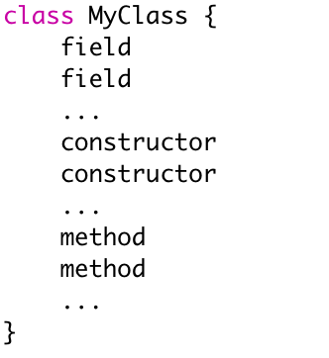
Class structure

Slide 5
Scopes
Scope | Who can access
private | only the class
package-private (default) | only package members
protected | class, package members, subclasses
public | everyone

Slide 6
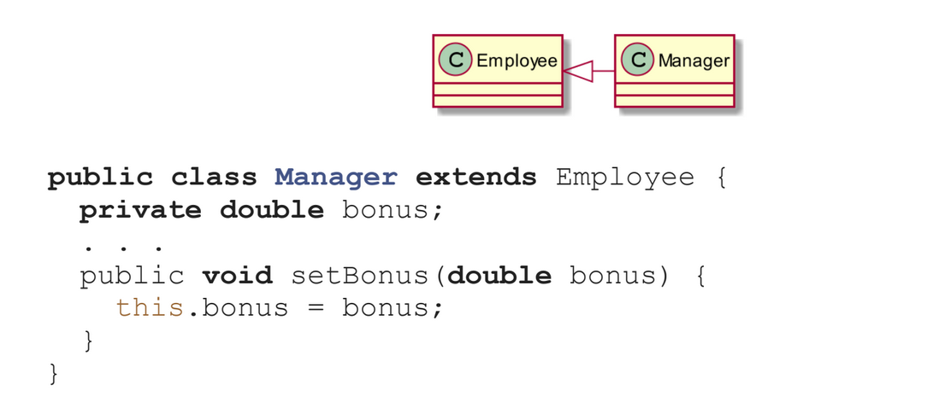
Inheritance

Slide 7
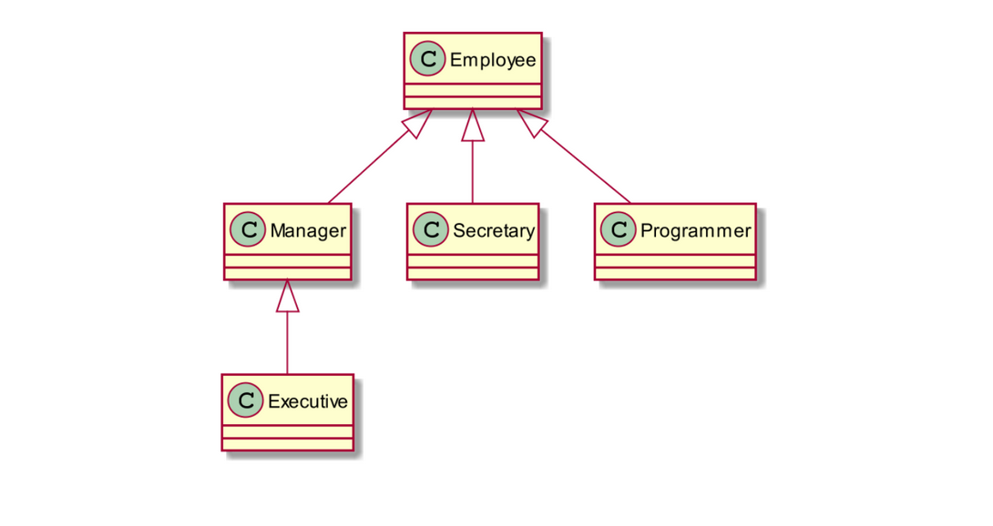
Inheritance

Slide 8
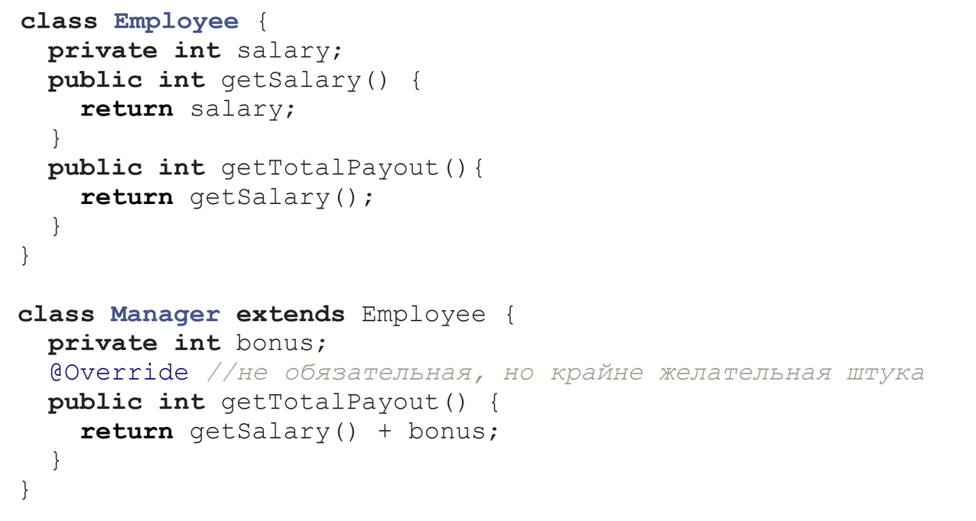
Overriding

Slide 9
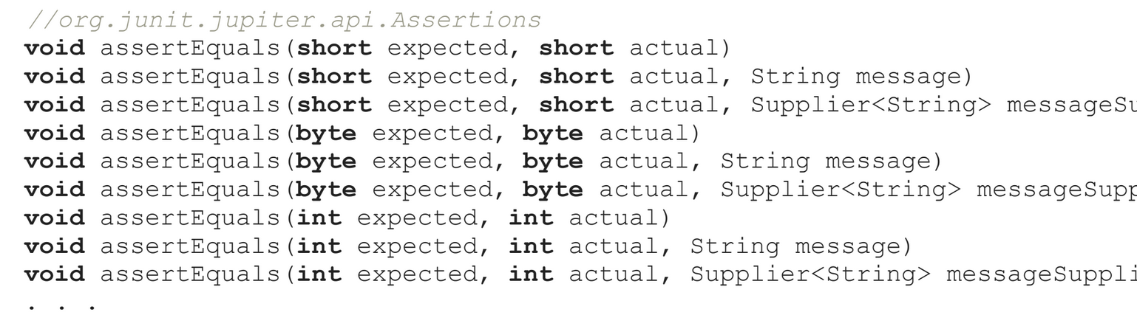
Overloading

Slide 10
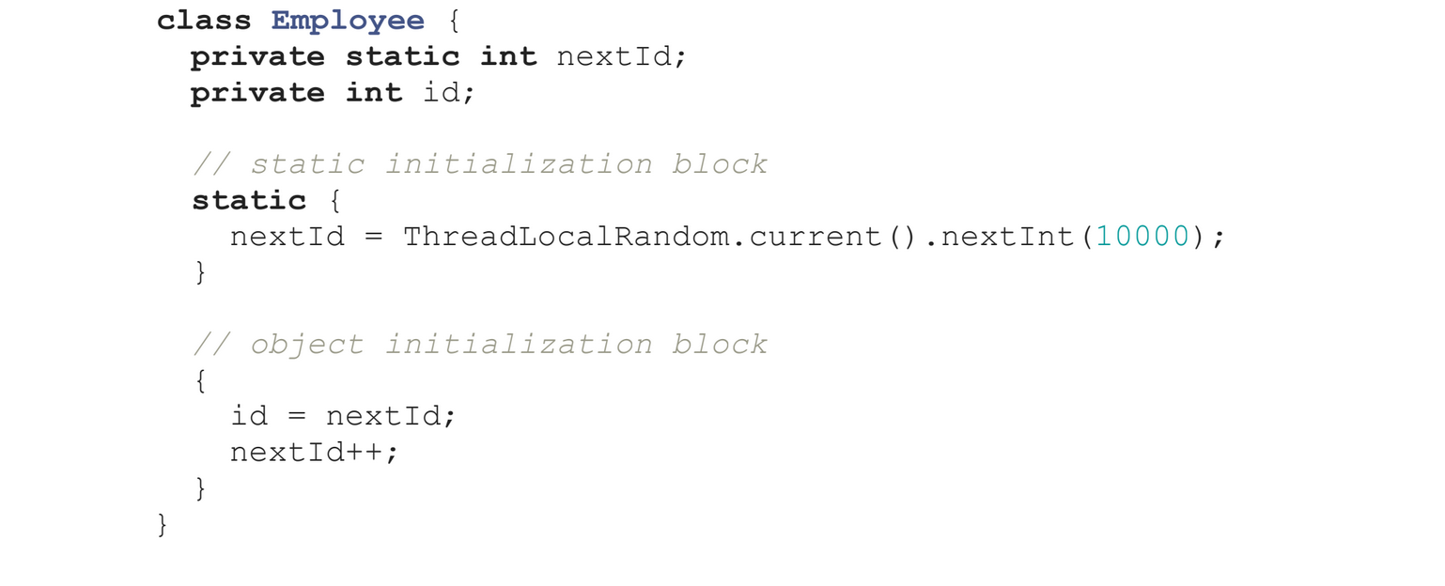
Initialization

Slide 11
Interfaces
Contain methods without implementations
Since JDK8 default methods are available
Since JDK8 static methods are available
Since JDK9 private methods are available
Accessible in interface only
Don’t have default implementation
Can contain static constants (public static final by default)
Interface inheritance is available

Slide 12
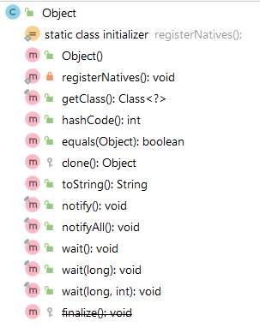
Object class

